Slide 1
A Personalized Travel Planning And Tracking App
Team Members:
P K Dharaneesh-711222104010
D D Vsanth-711222104059
T Durai-711222104013
R Saravana Kumar-711222104041

Slide 2
DESCRIPTION
Overview: Study App is a mobile application designed to enhance students' learning experiences. It provides various tools to help users keep track of their studies, take notes, and engage in interactive quizzes. The app ensures that students can conveniently manage their study material, making it a comprehensive and accessible solution for learning on the go.
Material Design: Study App is built with Material Design principles, providing a modern, user-friendly interface. Elements such as floating action buttons, intuitive navigation, and a clean color scheme enhance the overall user experience.
Customizable Settings: Users can customize their experience within Study App. Options like theme selection and personalized preferences make the app adaptable to individual needs.
Offline Mode: Study App functions both online and offline, allowing users to access their notes and quizzes without needing an internet connection. Perfect for studying anywhere, anytime.
Quiz Module: Study App includes an interactive quiz feature that helps users test their knowledge on various subjects. It’s a quick way for students to assess their understanding and retain important information.
Notes Section: A well-organized notes feature allows users to jot down important points during lectures or while studying. The intuitive layout makes it easy to create, edit, and manage notes, ensuring key information is always accessible.

Slide 3
Main Activity.java:
<?xml version="1.0" encoding="utf-8"?>
<manifest xmlns:android="http://schemas.android.com/apk/res/android"
xmlns:tools="http://schemas.android.com/tools">
<application
android:allowBackup="true"
android:dataExtractionRules="@xml/data_extraction_rules"
android:fullBackupContent="@xml/backup_rules"
android:icon="@mipmap/ic_launcher"
android:label="@string/app_name"
android:supportsRtl="true"
android:theme="@style/Theme.TravelApp"
tools:targetApi="31">
<activity
android:name=".RegisterActivity"
android:exported="false"
android:label="RegisterActivity"
android:theme="@style/Theme.TravelApp" />

Slide 4
<activity
android:name=".ParisActivity"
android:exported="false"
android:label="@string/title_activity_paris"
android:theme="@style/Theme.TravelApp" />
<activity
android:name=".BaliActivity"
android:exported="false"
android:label="@string/title_activity_bali"
android:theme="@style/Theme.TravelApp" />
<activity
android:name=".MainActivity"
android:exported="true"
android:label="@string/app_name"
android:theme="@style/Theme.TravelApp"/>
<activity
android:name=".LoginActivity"
android:exported="true"
android:label="@string/app_name"
android:theme="@style/Theme.TravelApp">

Slide 5
AndroidManifest.xml
<intent-filter>
<action android:name="android.intent.action.MAIN" />
<category android:name="android.intent.category.LAUNCHER" />
</intent-filter>
</activity>
</application>
</manifest>
<?xml version="1.0" encoding="utf-8"?>
<manifest
xmlns:android="http://schemas.android.com/apk/res/android"
xmlns:tools="http://schemas.android.com/tools"
package="com.materialstudies.owl">
<!--Load images from Unsplash-->
<uses-permission android:name="android.permission.INTERNET"/>
<application
android:allowBackup="true"
android:icon="@mipmap/ic_launcher"
android:label="@s

Slide 6
<activity
android:name=".ui.MainActivity"
android:theme="@style/Owl.Blue">
<intent-filter>
<action android:name="android.intent.action.MAIN"/>
<category android:name="android.intent.category.LAUNCHER"/>
</intent-filter>
</activity>
<!--Preload custom fonts-->
<meta-data
android:name="preloaded_fonts"
android:resource="@array/preloaded_fonts"/>
<meta-data
android:name="fontProviderRequests"
android:value="Rubik"/>
</application>
</manifest>

Slide 7
FONT
rubik.xml
<?xml version="1.0" encoding="utf-8"?>
<font-family
xmlns:app="http://schemas.android.com/apk/res-auto"
app:fontProviderAuthority="com.google.android.gms.fonts"
app:fontProviderPackage="com.google.android.gms"
app:fontProviderQuery="Rubik"
app:fontProviderCerts="@array/com_google_android_gms_fonts_certs">
</font-family>
rubik_bold.xml
<?xml version="1.0" encoding="utf-8"?>
<font-family
xmlns:app="http://schemas.android.com/apk/res-auto"
app:fontProviderAuthority="com.google.android.gms.fonts"

Slide 8
app:fontProviderPackage="com.google.android.gms"
app:fontProviderQuery="name=Rubik&amp;weight=700"
app:fontProviderCerts="@array/com_google_android_gms_fonts_certs">
</font-family>
rubik_medium.xml
<?xml version="1.0" encoding="utf-8"?>
<font-family
xmlns:app="http://schemas.android.com/apk/res-auto"
app:fontProviderAuthority="com.google.android.gms.fonts"
app:fontProviderPackage="com.google.android.gms"
app:fontProviderQuery="name=Rubik&amp;weight=500"
app:fontProviderCerts="@array/com_google_android_gms_fonts_certs">
</font-family>

Slide 9
LAYOUT
activity_main.xml
<?xml version="1.0" encoding="utf-8"?>
<layout
xmlns:android="http://schemas.android.com/apk/res/android"
xmlns:app="http://schemas.android.com/apk/res-auto"
xmlns:tools="http://schemas.android.com/tools">
<LinearLayout
android:id="@+id/root"
android:layout_width="match_parent"
android:layout_height="match_parent"
android:orientation="vertical"
app:layoutFullscreen="@{true}"
tools:context=".ui.MainActivity">
<fragment
android:id="@+id/nav_host"
android:name="androidx.navigation.fragment.NavHostFragment"
android:layout_width="match_parent"
android:layout_height="0dp"

Slide 10
android:layout_weight="1"
app:defaultNavHost="true"
app:navGraph="@navigation/navigation"/>
<com.google.android.material.bottomnavigation.BottomNavigationView
android:id="@+id/bottom_nav"
android:layout_width="match_parent"
android:layout_height="wrap_content"
android:visibility="gone"
app:menu="@menu/main"/>
</LinearLayout>
</layout>
Course_item.xml
<?xml version="1.0" encoding="utf-8"?>
<layout
xmlns:android="http://schemas.android.com/apk/res/android"
xmlns:app="http://schemas.android.com/apk/res-auto"
xmlns:tools="http://schemas.android.com/tools"
tools:targetApi="o"
tools:ignore="RtlSymmetry">

Slide 11
<data>
<variable
name="course"
type="com.materialstudies.owl.model.Course"/>
<variable
name="clickHandler"
type="com.materialstudies.owl.ui.mycourses.CourseViewClick"/>
</data>
<androidx.constraintlayout.widget.ConstraintLayout
android:id="@+id/course_item"
android:layout_width="match_parent"
android:layout_height="wrap_content"
android:layout_marginStart="32dp"
android:onClick="@{(v) -> clickHandler.onClick(v, course.id)}"
android:transitionName="@{course.name}"
android:theme="@style/ThemeOverlay.Owl.TransitionShapeAppearance.Small">
<View
android:id="@+id/background"
android:layout_width="0dp"
android:layout_height="0dp"
app:layout_constraintEnd_toEndOf="parent"

Slide 12
app:layout_constraintTop_toTopOf="@id/course_name"
app:layout_constraintBottom_toBottomOf="@id/course_steps"
app:layout_constraintStart_toStartOf="@id/course_name"
app:elevationOverlay="@{@dimen/card_elevation}"/>
<Space
android:id="@+id/space"
android:layout_width="0dp"
android:layout_height="0dp"
app:layout_constraintStart_toStartOf="parent"
app:layout_constraintTop_toTopOf="parent"
app:layout_constraintEnd_toStartOf="@id/course_image"/>
<ImageView
android:id="@+id/course_image"
android:layout_width="0dp"
android:layout_height="0dp"
app:layout_constraintStart_toEndOf="@id/space"
app:layout_constraintEnd_toStartOf="@id/course_name"
app:layout_constraintTop_toTopOf="@id/course_name"
app:layout_constraintBottom_toBottomOf="@id/course_steps"
app:layout_constraintDimensionRatio="1:1"
app:srcCompat="@drawable/stroked_course_image_placeholder"

Slide 13
android:scaleType="centerCrop"
android:contentDescription="@{course.thumbContentDesc}"/>
<TextView
android:id="@+id/course_name"
android:layout_width="0dp"
android:layout_height="wrap_content"
app:layout_constraintStart_toEndOf="@id/course_image"
app:layout_constraintTop_toTopOf="parent"
app:layout_constraintEnd_toEndOf="parent"
app:layout_constraintHorizontal_weight="1"
android:paddingHorizontal="@dimen/grid_2"
android:paddingTop="@dimen/grid_2"
android:lines="2"
android:ellipsize="end"
android:text="@{course.name}"
android:textAppearance="?attr/textAppearanceSubtitle1"
tools:text="@sample/courses.json/data/name"/>
<ImageView
android:id="@+id/course_icon"
android:layout_width="wrap_content"
android:layout_height="wrap_content"

Slide 14
app:layout_constraintStart_toStartOf="@id/course_name"
app:layout_constraintTop_toTopOf="@id/course_steps"
app:layout_constraintBottom_toBottomOf="@id/course_steps"
android:paddingStart="@dimen/grid_2"
app:srcCompat="@drawable/ic_course"
app:tint="?attr/colorPrimary"
android:importantForAccessibility="no"/>
<TextView
android:id="@+id/course_steps"
android:layout_width="0dp"
android:layout_height="wrap_content"
app:layout_constraintStart_toEndOf="@id/course_icon"
app:layout_constraintEnd_toStartOf="@id/course_instructor"
app:layout_constraintTop_toBottomOf="@id/course_name"
app:layout_constraintBottom_toBottomOf="parent"
android:paddingStart="@dimen/grid_1"
android:paddingVertical="@dimen/grid_2"
android:textColor="?attr/colorPrimary"
android:textAppearance="?attr/textAppearanceCaption"
android:text="@{@string/course_steps(course.step, course.steps)}"
tools:text="@sample/courses.json/data/step"/>

Slide 15
<ImageView
android:id="@+id/course_instructor"
android:layout_width="28dp"
android:layout_height="28dp"
app:layout_constraintEnd_toEndOf="parent"
app:layout_constraintStart_toEndOf="@id/course_steps"
app:layout_constraintTop_toTopOf="@id/course_steps"
app:layout_constraintBottom_toBottomOf="@id/course_steps"
android:layout_marginEnd="@dimen/grid_2"
app:srcUrl="@{course.instructor}"
app:placeholder="@{@drawable/ic_avatar_placeholder}"
app:circleCrop="@{true}"
android:importantForAccessibility="no"/>
<View
android:id="@+id/highlight"
android:layout_width="0dp"
android:layout_height="0dp"
app:layout_constraintStart_toStartOf="@id/course_image"
app:layout_constraintTop_toTopOf="parent"
"

Slide 16
package com.example.travelappimport
androidx.test.platform.app.InstrumentationRegistryimport
androidx.test.ext.junit.runners.AndroidJUnit4import org.junit.Testimport
org.junit.runner.RunWithimport org.junit.Assert.
*/** * Instrumented test, which will execute on an Android device.
* * See [testing documentation](http://d.android.com/tools/testing).
*/@RunWith(AndroidJUnit4::class)class ExampleInstrumentedTest { @Test fun useAppContext() { // Context of the app under test.
val appContext = InstrumentationRegistry.getInstrumentation().targetContext assertEquals("com.example.travelapp", appContext.packageName) }}

Slide 17
android:theme="@style/Owl.Blue"
app:paddingTopSystemWindowInsets="@{true}"
app:paddingLeftSystemWindowInsets="@{true}"
app:paddingRightSystemWindowInsets="@{true}"
tools:context=".ui.search.SearchFragment">
<com.google.android.material.appbar.AppBarLayout
android:layout_width="match_parent"
android:layout_height="wrap_content"
app:liftOnScroll="true"
app:liftOnScrollTargetViewId="@id/search_results"
android:theme="@style/ThemeOverlay.Owl.Blue.Dark">
<androidx.appcompat.widget.Toolbar
android:layout_width="match_parent"
android:layout_height="wrap_content"
app:layout_scrollFlags="scroll|enterAlways|snap"
android:minHeight="?attr/actionBarSize"
app:navigationIcon="@drawable/ic_search"
app:contentInsetStartWithNavigation="0dp"
app:menu="@menu/account">

Slide 18
app:layout_behavior="com.google.android.material.appbar.AppBarLayout$ScrollingViewBehavior"
app:layoutManager="androidx.recyclerview.widget.LinearLayoutManager"
app:hasFixedSize="@{true}"
android:scrollbars="vertical"
tools:listitem="@layout/search_item"/>
</androidx.coordinatorlayout.widget.CoordinatorLayout>
</layout>

Slide 19
<EditText
android:layout_width="match_parent"
android:layout_height="wrap_content"
android:background="@null"
android:lines="1"
android:selectAllOnFocus="true"
android:inputType="textCapWords"
android:imeOptions="actionSearch"
android:hint="@string/search_owl"
android:textAppearance="?attr/textAppearanceSubtitle1"/>
</androidx.appcompat.widget.Toolbar>
</com.google.android.material.appbar.AppBarLayout>
<androidx.recyclerview.widget.RecyclerView
android:id="@+id/search_results"
android:layout_width="match_parent"
android:layout_height="match_parent"

Slide 20
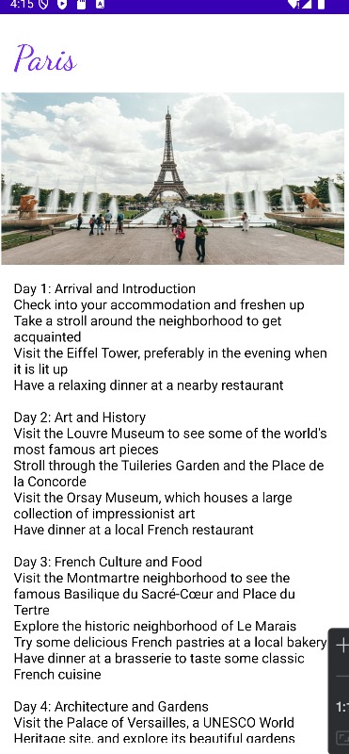
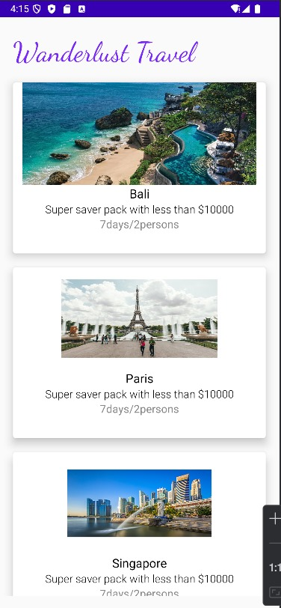
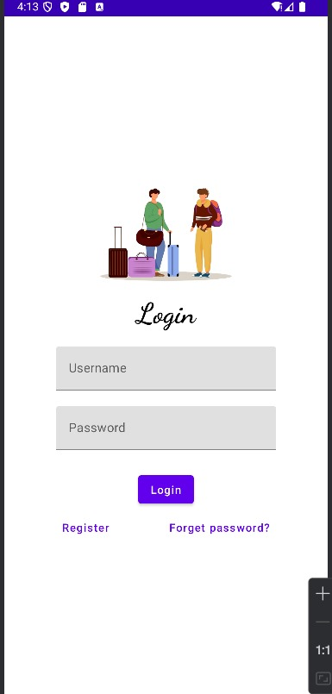
OUTPUT:

Slide 21
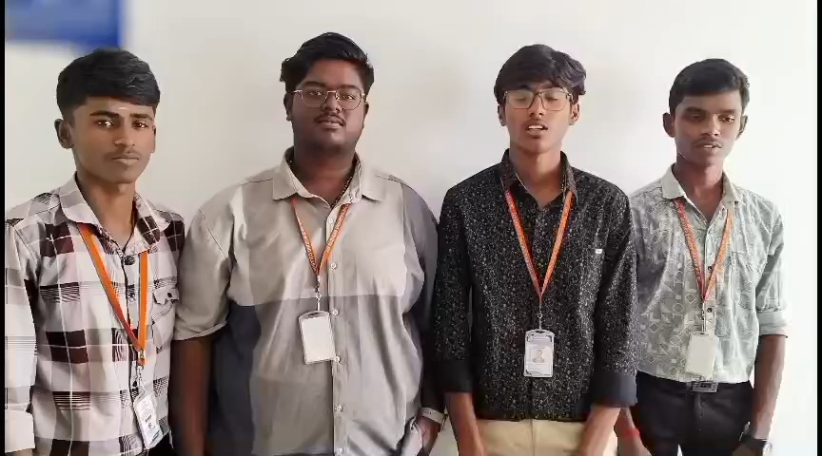
Demo video:

